Slide 1
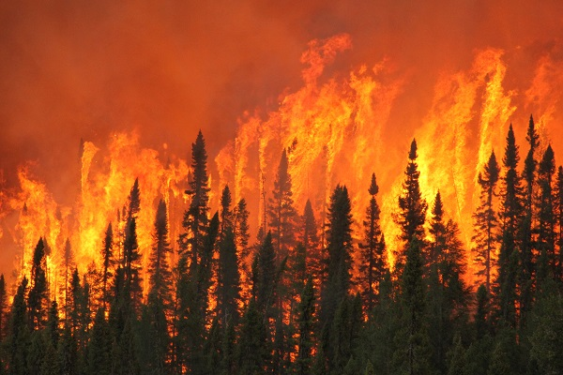
Forest Fires Prediction
Forest fires cause great environmental damage
Predicting and preventing forest fires would save human, animal and plant lives

Slide 2
Objectives
To predict area burned by a forest fire:
Regression Analysis
  Multiple Linear Regression
  Regression Trees
  Random Forest
To predict large or small forest fires:
Classification
  Logistic Regression
Validate models using cross-validation

Slide 3
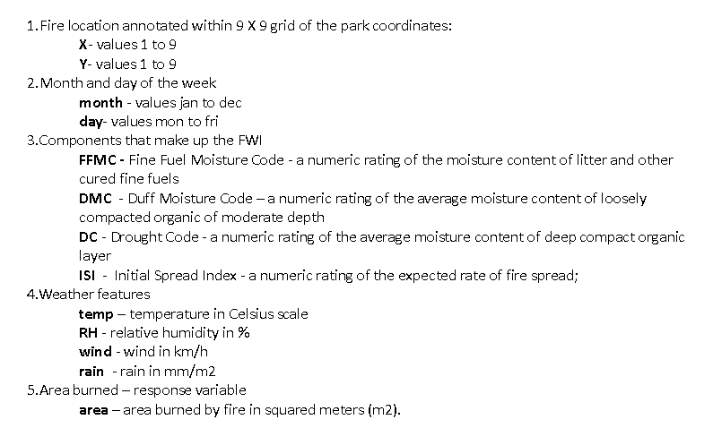
Data set information
https://archive.ics.uci.edu/ml/datasets/Forest+Fires

Slide 4
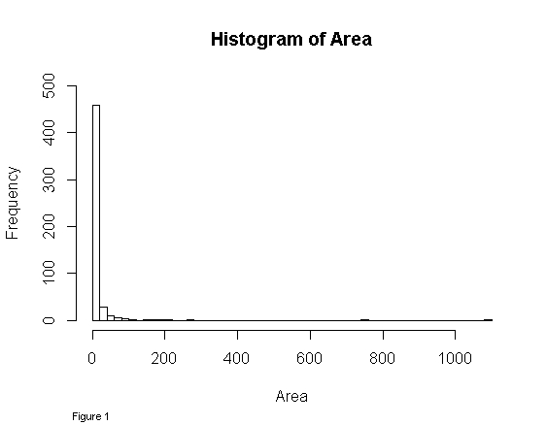
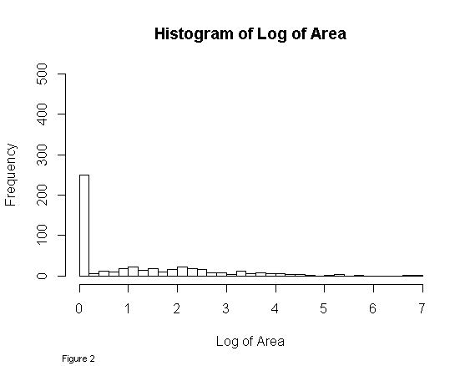
Data Challenges
Data Skewness
Perform cross validation on a small data set

Slide 5
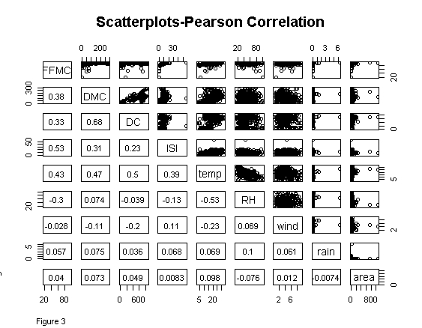
Data Challenges - Continued
Data correlation

Slide 6
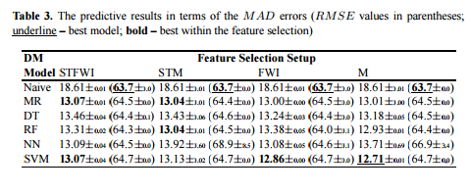
Benchmark
http://www3.dsi.uminho.pt/pcortez/fires.pdf

Slide 7
Multiple Linear Regression
Stepwise variable selection
Polynomials
Variable Interactions
All models were validated using 10-fold cross validation repeated 30 times

Slide 8
Multiple Linear Regression
 | Model description | Model name | R-Squared | Adjusted R-squared | RMSE | MAD
1 | Numeric variables (weather and fire index) | lm.wf | 0.01988 | 0.004446 | 64.44124 | 12.93817
1a | Numeric stepwise (selected significant variables: RH, wind and RH) | stepB | 0.01425 | 0.008485 | 64.44783 | 12.95806
2 | All variables including factor variables: season, wday and coordinates | lm.all | 0.05259 | 0.01835 | 64.33444 | 12.85998
2a | Stepwise of the previous model (selected significant variables: DMC, wind, temperature and season) | stepC | 0.0377 | 0.02638 | 64.39118 | 12.89213
3 | Polynomial terms applied on the model above plus rain^2 | lm.poly | 0.06256 | 0.03834 | 64.34547 | 12.78232
3a | Model above plus DC^2 | lm.polyDC | 0.06999 | 0.04215 | 64.30157 | 12.75959
4 | Interactions on the model 2a | stepD | 0.05421 | 0.03552 | 64.35089 | 12.79311
4a | Interactions with all variables | stepE | 0.1533 | 0.07245 | 64.06452 | 12.47535

Slide 9
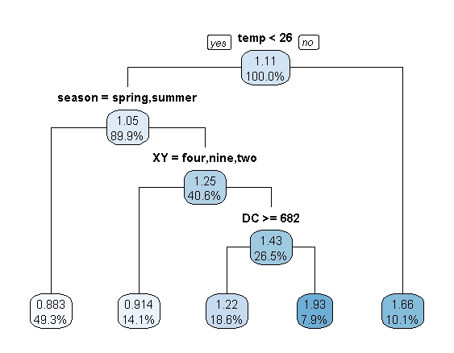

Regression Tree Modeling
Regression Trees
Random forest
Model using all predictors with 100 trees had RMSE of 64.39, MAD of 13.15

Slide 10
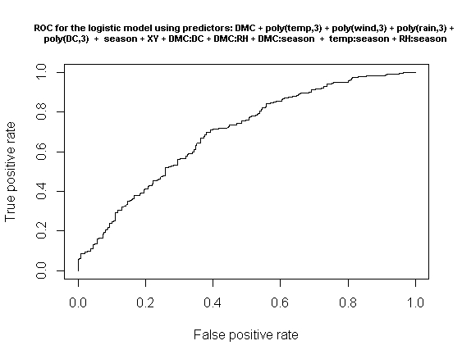
Classification Prediction
Logistic Regression
The best mode Area Under Curve has 70%

Slide 11
Conclusion
Predicting and preventing forest fires would save human, animal and plant lives and reduce greenhouse effect which is negatively affecting our lives in all aspects
Multiple linear regression – using polynomial terms and interactions I was able to obtain a cross-validated linear model with higher accuracy
The tree-based models (regression tree and random forest) have not improved over the linear models and in the case of regression trees did not result in predictive models that would generalize well to new, unseen data.
The Logistic regression classification model proved to be a very good model to predict whether the fire would be small or large. The 10-fold cross-validated value (repeated 30 times) for AUC was 70%. This model can be useful in a way that would allow park and government authorities to better plan the resources in advance depending on weather the fire has been predicted to be large or small.

